Slide 1
Come and See A Wonderful Life
“He has done everything well!” Mark 7:37

Slide 2
Scripture: Mark 7:31-35
Then Jesus left the vicinity of Tyre and went through Sidon, down to the Sea of Galilee and into the region of the Decapolis. There some people brought to him a man who was deaf and could hardly talk, and they begged him to place his hand on the man.
After he took him aside, away from the crowd, Jesus put his fingers into the man's ears. Then he spit and touched the man's tongue. He looked up to heaven and with a deep sigh said to him, "Ephphatha!" (which means, "Be opened!").

Slide 3
Mark 7:36-37
At this, the man's ears were opened, his tongue was loosened and he began to speak plainly.
Jesus commanded them not to tell anyone. But the more he did so, the more they kept talking about it. People were overwhelmed with amazement. "He has done everything well," they said. "He even makes the deaf hear and the mute speak."

Slide 4
Key Text:
“He has done everything well!” Mark 7:37

Slide 5
Why did the people say that Jesus had done all things well?

Slide 6
They Sensed His Powerful Prayer Connection
Jesus’ prayer habits.
For special needs - “He looked up to heaven.” V. 34
Regularly and often - “Jesus often withdrew to lonely places and prayed.” Luke 5:16
Jesus’ prayer attitude.
Father-Son connection. John 11:41
Humility - “I do nothing on my own but speak just what the Father has taught me” John 8:28

Slide 7
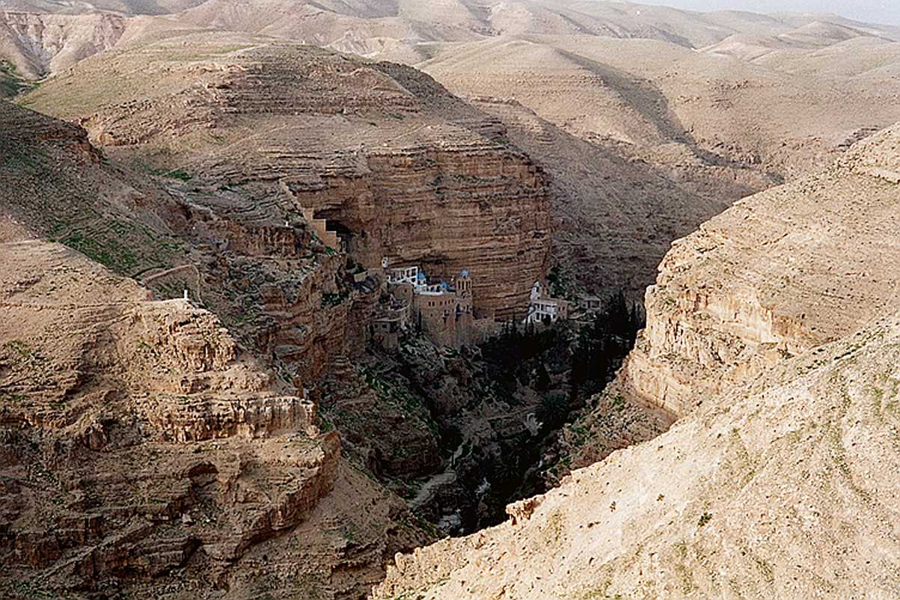
He Had Ready Communication With His Father.
Awareness of God’s presence
“I am in the Father and the Father is in me” John 14:11
Discernment of God’s will
Luke 4:43

Slide 8
He Showed Perfect Dependence Upon the Holy Spirit.
Power through depending on God.
“I am in the Father, and that the Father is in me? The words I say to you are not just my own. Rather, it is the Father, living in me, who is doing his work.” John 14:10 NIV
Faith

Slide 9
They Saw Jesus’ Perfect Life
Jesus was sinless.
“We have one who has been tempted in every way, just as we are-yet was without sin.” Heb 4:15-16 NIV

Slide 10
They Saw Jesus’ Perfect Love
He was perfect in love and compassion.

Slide 11
They saw the results of a fruitful life in people’s lives.
Miraculous healings
Spiritual insights from his teaching
Followers renewed in mind and spirit.

Slide 12
Our Response

Slide 13
Key Thought:
When we see the wonderful exemplary human life of Jesus,
We respond with worship.
And we respond with renewed desire to follow him.

Slide 14
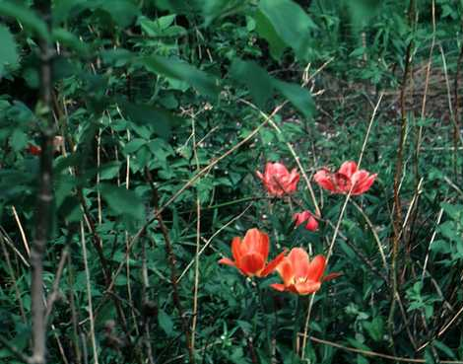
Worship
Filled with wonder and awe
Adoration and praise
Modelling after His prayer life

Slide 15
Living our lives in ways to please Him
Forsaking intentional sins
Growing in love and compassion
Serving God and others

